Slide 1



Plant Disease Prediction System for Sustainable Agriculture

Slide 2

Learning Objectives
Understand the role of Artificial Intelligence (AI) and Deep Learning in Agriculture 🌱.
Learn Image Classification using Convolutional Neural Networks (CNNs) and EfficientNetB0 🧠.
Implement image preprocessing techniques such as augmentation, normalization, and resizing 🖼️.
Optimize model performance with transfer learning, dropout layers, and fine-tuning techniques ⚙️.
Evaluate model performance using Precision-Recall Curves, ROC Curves, and Grad-CAM Visualization 📊.
Deploy a real-time Plant Disease Prediction Web App using Streamlit 🚀.
Develop an end-to-end AI-powered agricultural tool that is accessible, scalable, and beneficial for farmers 🌍.
GOAL

Slide 3
Tools and Technology used
🛠 Tech Stack & Libraries:
Programming Language: Python 🐍
Deep Learning Framework: TensorFlow & Keras 🤖
Image Processing: OpenCV & PIL 🖼️
Data Handling: Pandas & NumPy 📊
Visualization: Matplotlib, Seaborn & Grad-CAM Heatmaps 🔥
Web Application Framework: Streamlit 🌐
Dataset Source: KaggleHub 📥
💡 Additional Tools Used:
Google Colab (for Model Training)

Slide 4
Methodology
Data Collection – Kaggle dataset with multiple plant diseases 🍃
Data Preprocessing – Rescaling, augmentation, normalization 🖼️
Model Selection – EfficientNetB0 for superior feature extraction 🔍
Training & Fine-Tuning – Dropout layers, learning rate optimization ⚙️
Model Evaluation – Accuracy, loss curves, Precision-Recall 📊
Model Explainability – Grad-CAM for heatmap visualization 🔥
Deployment – Streamlit Web App for user-friendly predictions 🌍

Slide 5
Problem Statement:
📌 Challenge:
Farmers struggle with identifying plant diseases early, leading to crop losses and reduced yield.
Traditional disease detection methods are time-consuming and inaccurate.
🔍 Why It Matters?
Early disease detection helps in timely intervention, higher yield, and sustainable agriculture.
A cost-effective, AI-powered solution can help farmers identify diseases early and prevent large-scale losses.

Slide 6
Solution:
A Deep Learning-based Plant Disease Detection System to classify plant leaf images into 38 disease categories.
Trained on Kaggle’s New Plant Diseases Dataset, ensuring high accuracy.
Uses EfficientNetB0, a state-of-the-art CNN model known for high performance.
Deployed as a Streamlit Web App, making it accessible on any device.
Includes Grad-CAM heatmaps for transparency, showing why the model made a specific prediction.
Provides disease diagnosis along with confidence scores to help farmers make informed decisions.

Slide 7
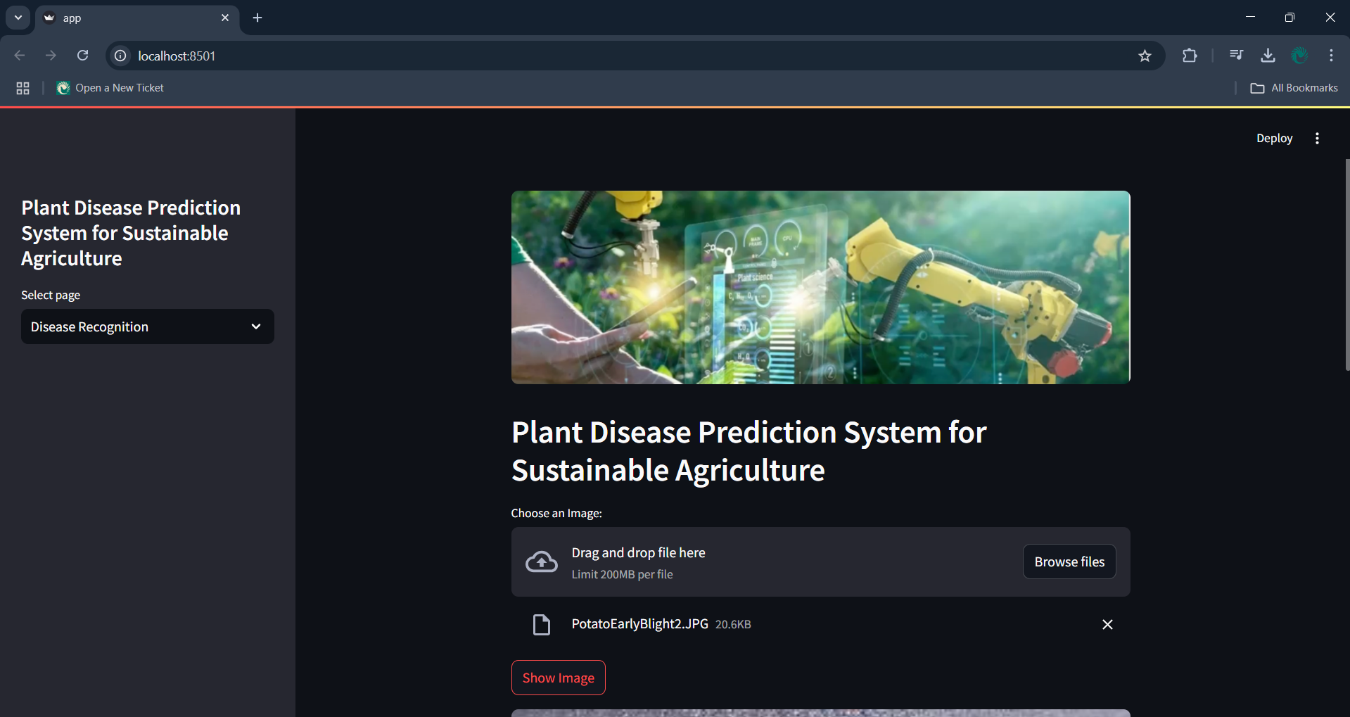
Screenshot of Output:

Slide 8
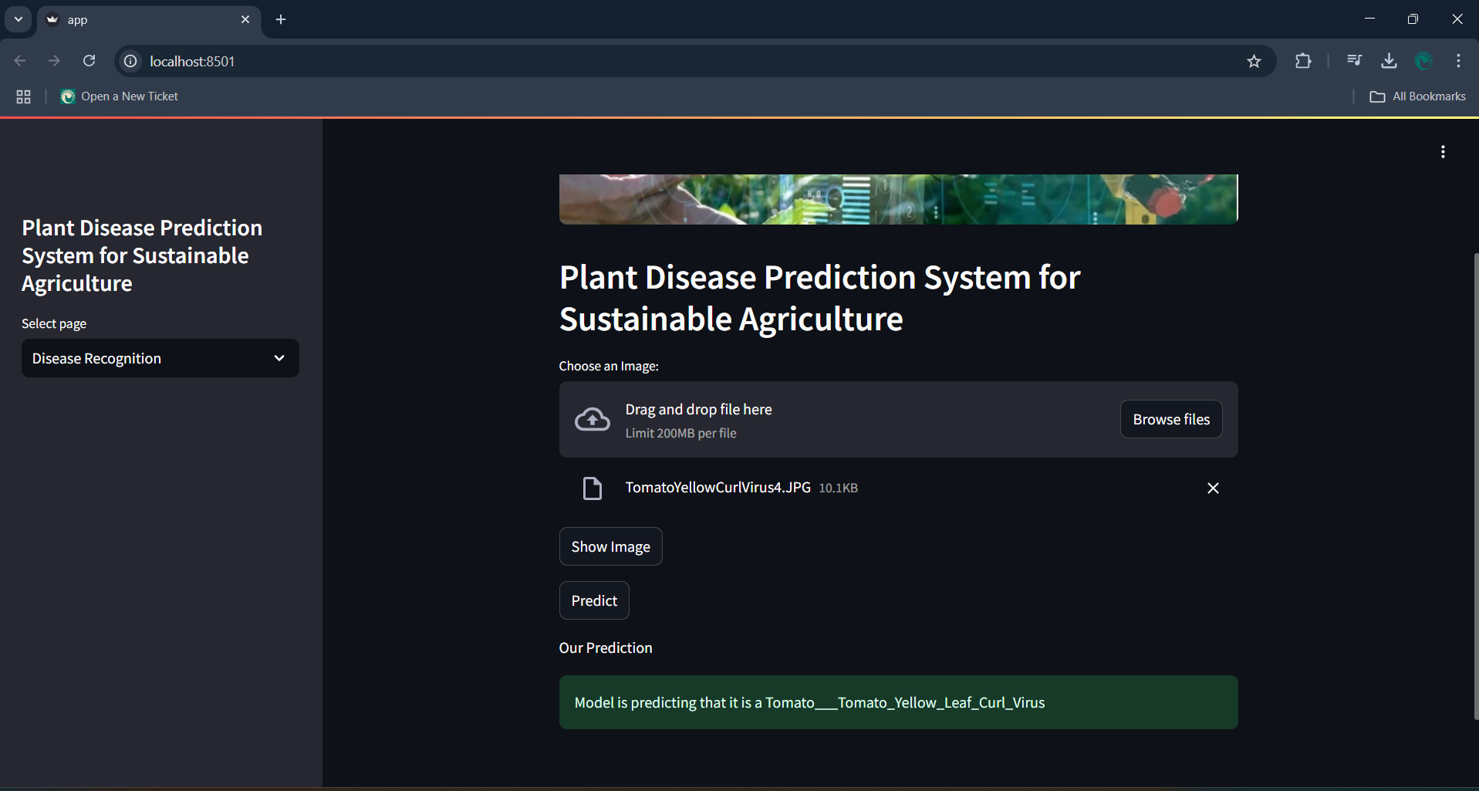
Screenshot of Output:

Slide 9
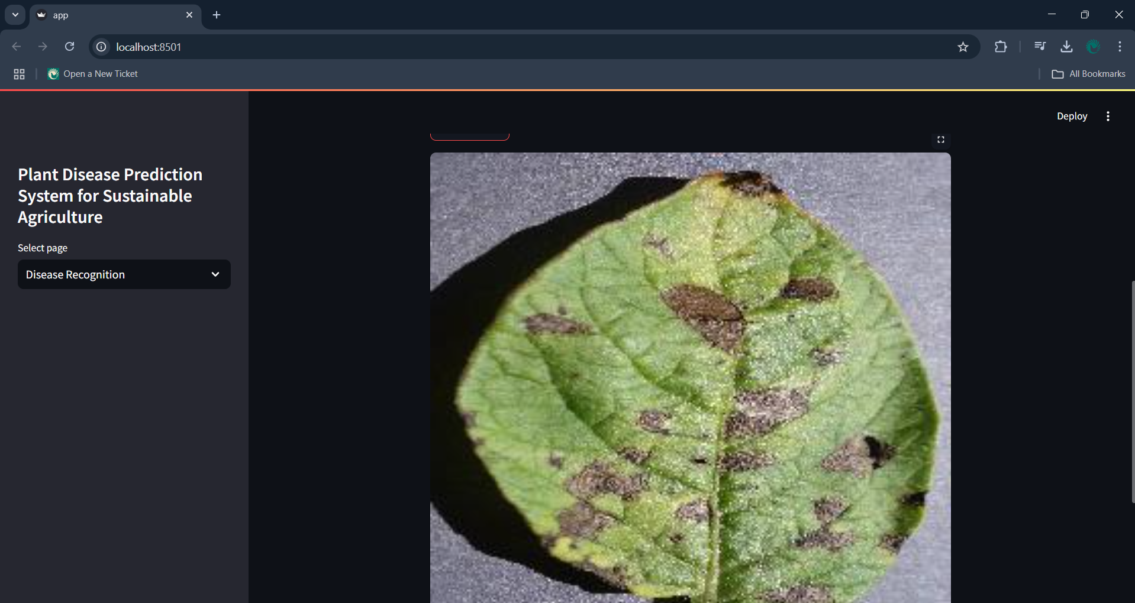
Screenshot of Output:

Slide 10
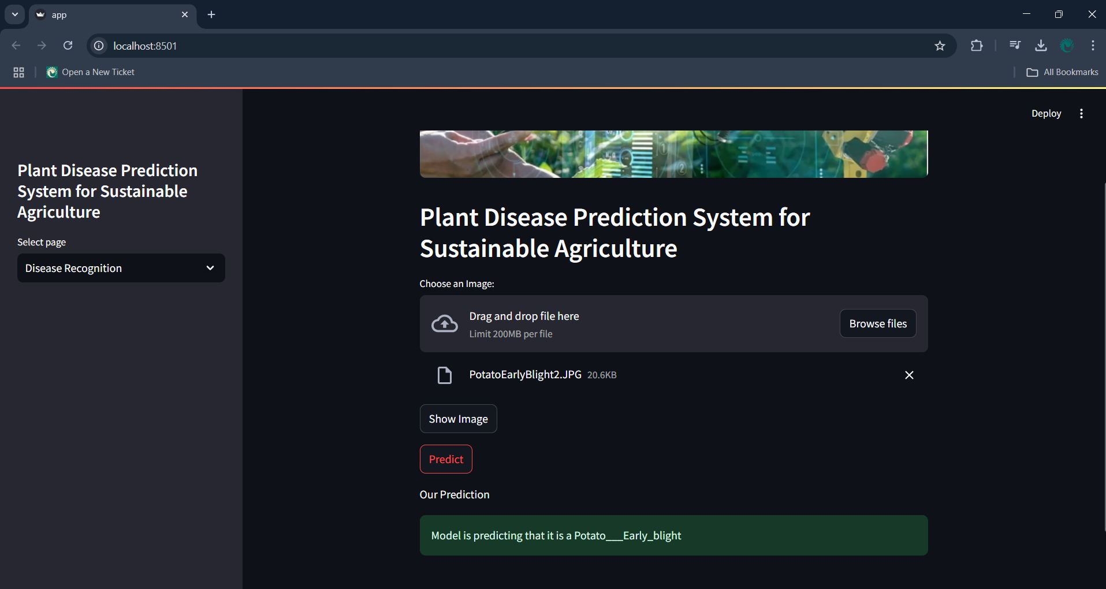
Screenshot of Output:

Slide 11
Conclusion:
Final Takeaways:
Successfully developed an AI-powered Plant Disease Classification Model.
Achieved high prediction accuracy using EfficientNetB0 and fine-tuning techniques.
Deployed the system as an interactive web application using Streamlit.
Integrated Grad-CAM visualization to provide explainability & trustworthiness in predictions.
🚀 Future Scope & Improvements: 1.Expand dataset to include more crop varieties. 2.Optimize the model for mobile applications (TensorFlow Lite). 3.Real-time integration with drones or IoT-based agriculture systems. 4.Multi-language support for better accessibility among farmers.

